Slide 1
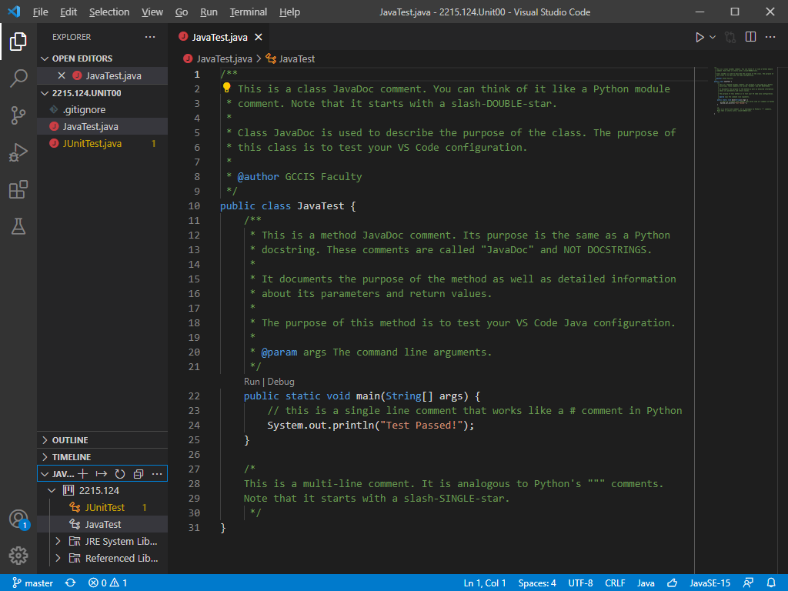
EXPLORER
Used to view project files & settings
RUN BUTTON
Used to run Java classes
DEBUG
Used to run Java programs through the debugger
EXTENSIONS
Used to install and manage extensions
TEST (FLASK)
Used to run JUnit unit tests

Slide 2
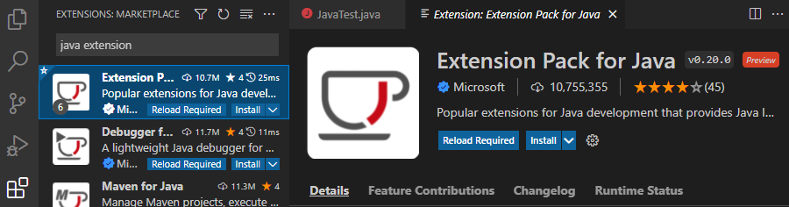

Slide 3
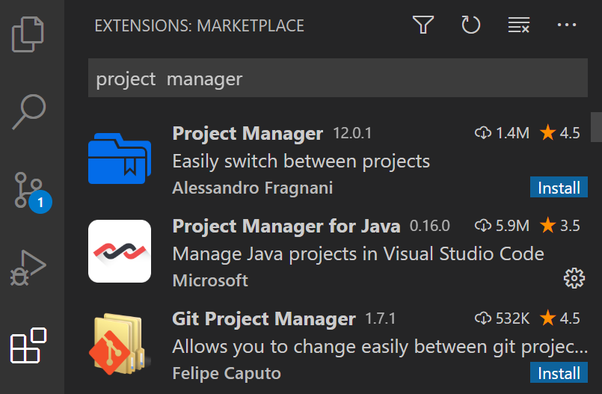
2. SEARCH
Type "Project Manager"
3. INSTALL
Look for "Project Manager for Java" and click Install.
1. EXTENSIONS
Used to install and manage extensions

